Slide 1


Slide 2
This PowerPoint is intended as a helpful guide for staff delivering DofE. I recognize the amount of time that staff give when helping with DofE and that any resources are useful to reduce staff work load.
Use the PowerPoint as you wish, it is YOUR responsibility to check that the information in these slides is correct at the time you use them. Read the notes attached to each slide to help you with the delivery of the PowerPoint. I have purposefully left spinal injuries out of the slides as it is (rightly so) seen as a “touchy” subject, therefore I shall let you decide what information you wish to share with your participants.
Additionally please email me on info@expededucation.org should you feel anything needs altering, this will keep the PowerPoint current, so many DofE groups can benefit from it.

Slide 3
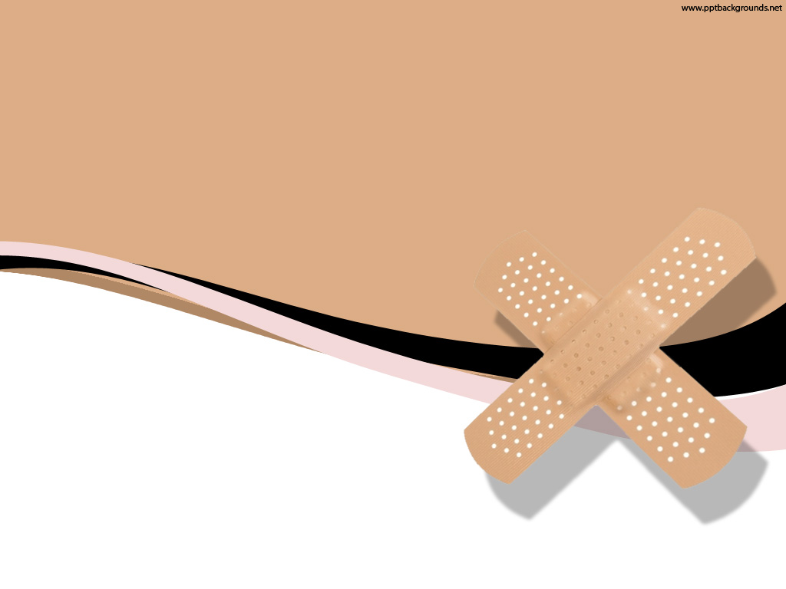



First Aid
Email: info@expededucation.org
Website: www.expededucation.org
@expededucation
Exped Education
Notes:
Really hammer home the importance of taking on board the training delivered.

Slide 4


3 P’s of First Aid
So something’s gone wrong out and about…
Preserve
Preserve Life – Can we do this?
Prevent
Prevent Deterioration – Can we do this?
Promote
Promote Recovery – Can we do this?
Notes:
If you are out on the hill, you cant realistically prevent a casualty from deteriorating further, they will get worse if you don’t get them to a hospital. This is the same for promoting their recovery, they need a hospital for this. You can however do your best to preserve a casualties life with decent first aid. Ask how we can preserve life – keep warm, call, be comfortable and wait (for help)

Slide 5
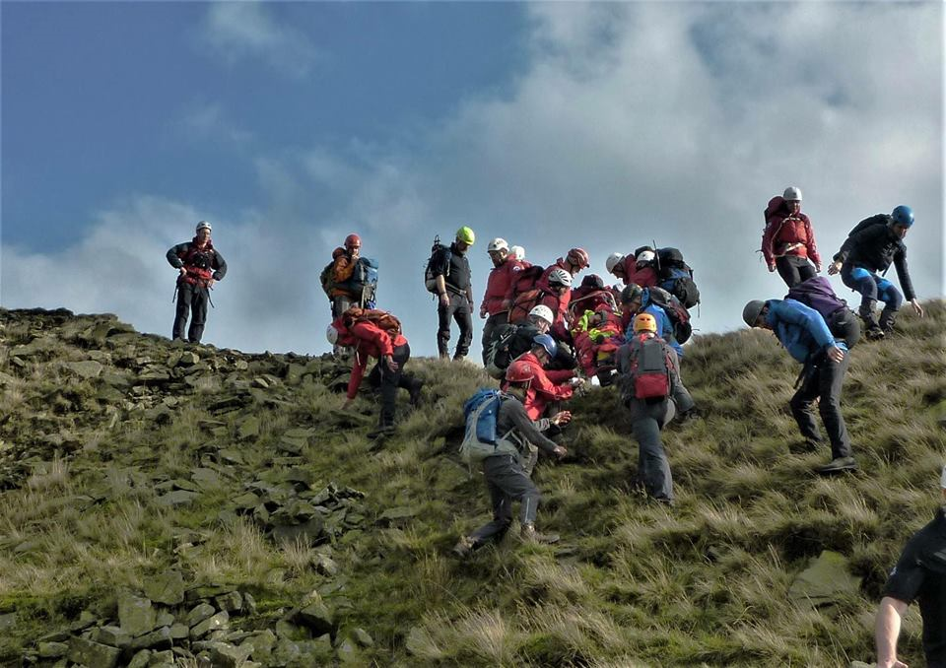
DRS ABC
D - Danger
R – Response
S - Shout
A - Airways
B - Breathing
C - Circulation
Jonathan on PDMRO training, October 2017
Notes:
Explain each point and it’s importance:
Danger – check your surroundings to make sure that you yourself don’t become a casualty. Priority = 1st yourself, 2nd your team, 3rd the casualty.
Response – see how the casualty responds to you; AVPU. Alert, Voice, Pain and Unresponsive. A P or U on AVPU is serious and the casualty needs medical help immediately.
Shout – call for help (shout, phone, signal).
Airways – check for obvious obstructions and remove if you can (if epileptic take care as they can bite fingers).
Breathing – count the amount of chest rises in 20 seconds (times this number by 3), if it is less than 8 breathes per minute then start CPR as they need assistance with breathing.
Circulation – Show them how to find a pulse (it’s a good idea to draw an X on the casualty when you find the pulse so you can easily go back to it). The pulse rate will vary as everyone is different; 60 to 80bpm is considered normal, however some peoples norm can be in the high 40’s! Anything lower than 45bpm (and they are looking unwell) is serious and CPR is needed!
While awaiting help and if not doing CPR keep going over ABC and record your findings to pass onto the ambulance service – it’s great if you can do this as it gives the crew a detailed insight into the casualties deterioration.

Slide 6
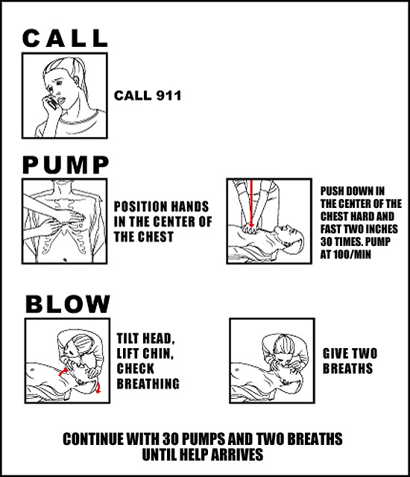
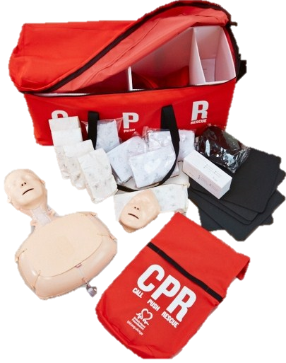

CPR
When shouldn’t you do CPR?
When the casualty has a catastrophic bleed. You must stop this before starting CPR.
Notes:
Show CPR video/do a demo. If you order the kit detailed below it comes with free demo videos.
Kits can be ordered for free to schools from: https://www.bhf.org.uk/heart-health/how-to-save-a-life/cpr-kits/cpr-training-for-schools
Get pupils to practice on ressusi annes (instruction on how to set these up are found in the Call Push Rescue kit).
You shouldn’t do CPR on a casualty with a catastrophic bleed, as you will just pump the blood out of the body faster! Stop the bleed first and then do CPR!

Slide 7
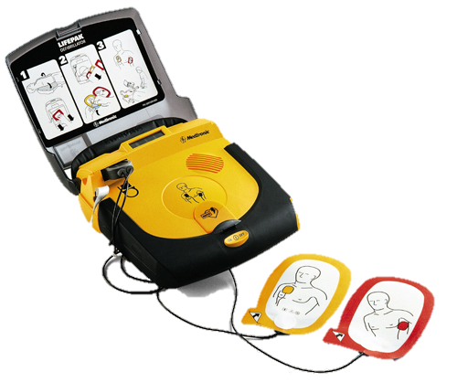

Defibrillator
Defibrillators are becoming increasingly common across the UK. They work great alongside CPR as they analyse the casualties heart rhythm and if needed will electrically shock the heart.
This shock is designed to stop the heart in the hope that it will “reset” itself into beating in a normal rhythm.
There are a number of apps now which list the locations of defibs and once you ring 999 they can also advise you on the location of them.
Notes:
Discuss Defib use. Used to shock the heart to stop working. Once stopped the heart will generally “reset” into a normal beating rhythm.
Click on the Bondi Rescue picture to see CPR and a defib being used in real life (warning this can be distressing).
There is an app called GOODSAM Alerter which can show you the locations of defibs across the UK. They are also working on defib locations in other countries. Various links to useful apps/websites can be found at: https://expededucation.org/links/

Slide 8
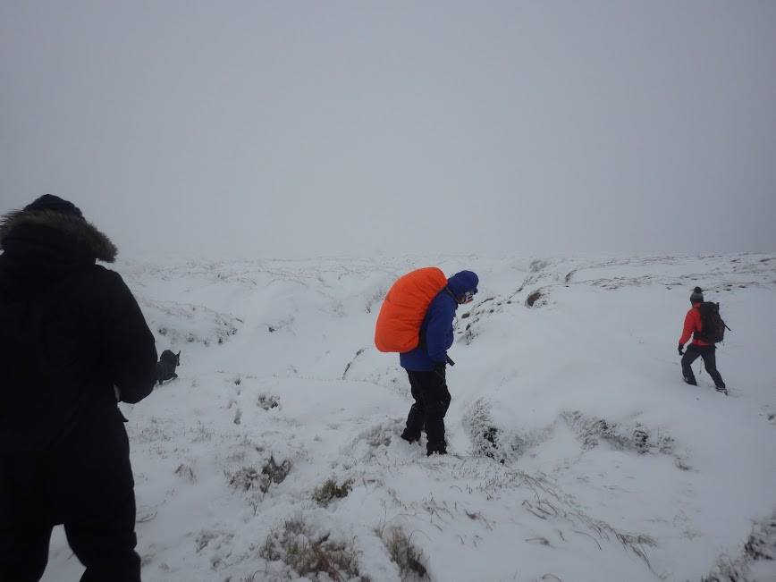
Hypothermia
Stages of hypothermia:
37° - Normal body temperature
36° - Feel cold
35° - Shivering
34° - Clumsy and confused
33° - Muscle stiffness
32° - Collapse
31° - Semiconscious
30° - Unconscious
29° - Slow breathing and slow pulse
28° - Dead
Jonathan, with friends on Kinder Scout January 2017
Hypothermia is your bodies response to the cold. It really doesn’t take much for hypothermia to take hold, just a few degrees of body temperature drop can be drastic. Ever chattered your teeth? Then you’ve probably had the first stages of hypothermia.
Notes:
Discuss the stages and discuss how to prevent this – gently warm the person up (get them off the ground, emergency shelter, extra layers, warm drink, sugary drink/treats, heat packs in groin, armpits and neck – where the arteries are). Discuss water borne hypothermia – remove all wet clothes and then add dry clothes (water zaps body heat 30x faster than air!)

Slide 9
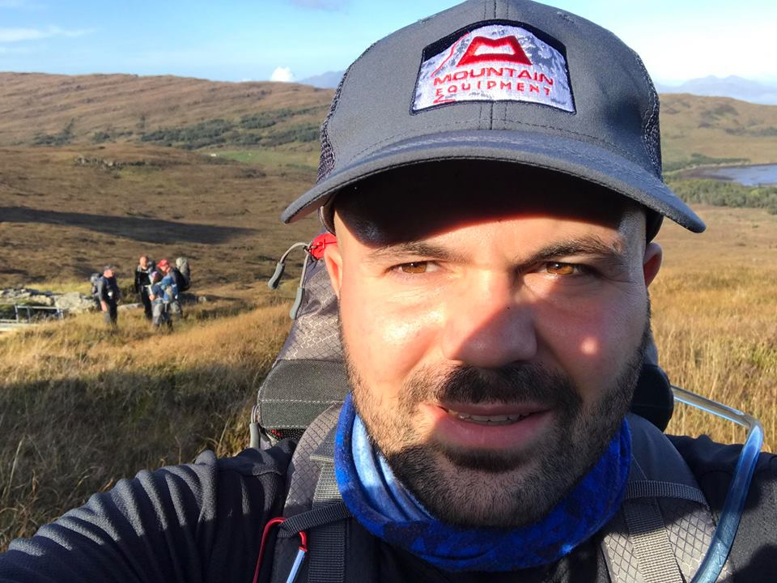
Hyperthermia
Hyperthermia is your bodies response to heat and how you regulate it. How I remember the difference between hyperthermia and hypothermia is in the spelling of the words. Hypothermia has a O in it, so does cold. Hyperthermia has a E in it, so does heat.
Stages of hyperthermia:
1. Heat Cramps: Abdominal, hamstring or calve cramps, along with feeling dehydrated.
2. Heat Exhaustion: Feel hot, thirsty, sick, headaches, may also be acting out of character (seem a little crazy!). Dizzy, weak and a rapid pulse.
3. Heat Stroke: Feeling really hot now 40°ish body temperature. They are acting really odd, not thinking straight. Begin to stop sweating, with skin becoming dry and hot. From here it is life threatening and they need to get to a hospital.
Jonathan on a warm day, on the Isle of Rum September 2017
Notes:
Discuss the stages and preventative measures – ensure that if giving fluids they are little and often as the body can only absorb so much at a time. You may think you are rehydrating someone by giving them lots to drink, however it will soon come out in their urine if you give them too much in one go.
How to prevent hyperthermia:
- Apply cold compresses to groin, armpits and neck – where the arteries are.
Give fluids little and often.
Lay the person down (let the ground absorb heat from them).
Place them in shade.
Fan them to cool them down.
Elevate their feet.

Slide 10
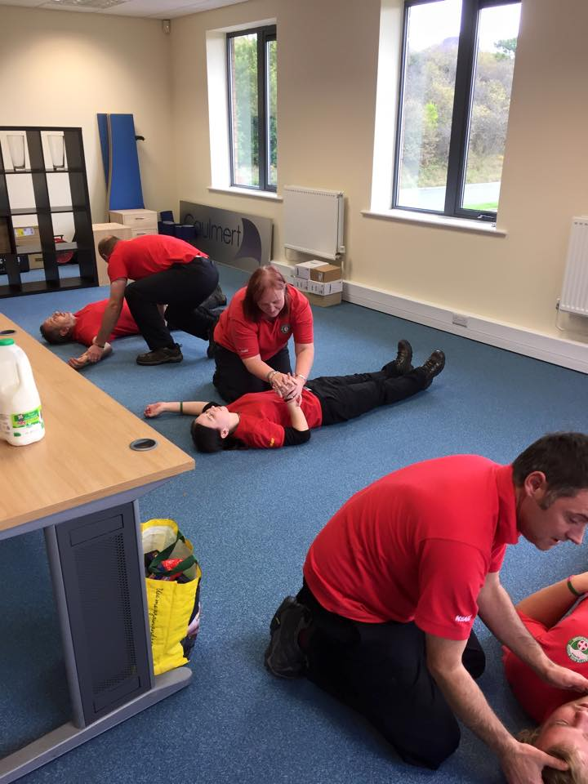

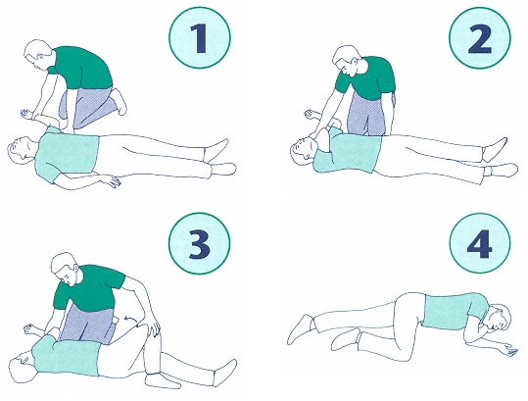
Recovery Position
Members of Nottinghamshire Search and Rescue Team practicing the recovery position October 2015
Notes:
Discuss and give a demo on recovery position.
Click on the British Red Cross picture for a video demo on this.

Slide 11
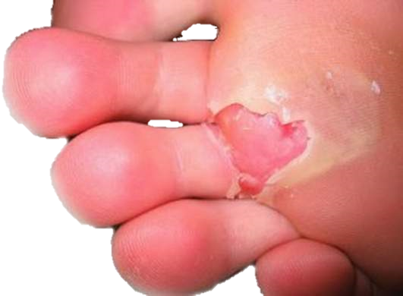
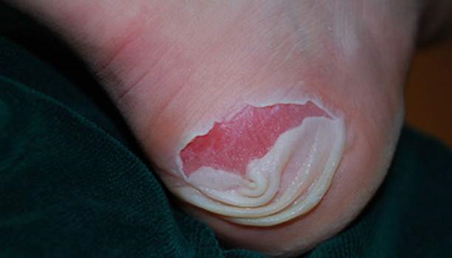
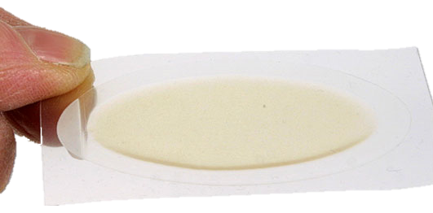
Blisters
Blisters are really uncomfortable to walk along with. They can be caused by a variety of different things, more often than not by not “wearing” your boots in. Put shortly; if you wear boots that you have recently got without “easing” into them first with short walks, the fabric hasn’t had the time to shape to your feet and in turn rubs.
Blister plasters are a great way to cover a blister. They provide a skin like layer which not only helps the blister to heal, but prevents others from forming.
Notes:
Why do they form? (skin lifts from flesh, through heat or friction – you can also get them from allergic reactions). Should we burst them? What’s available to cover them?
There’s so much conflicting information out there on whether you should or shouldn’t burst a blister. That decision I shall leave up to you to research and decide upon what information you give to your participants. I obviously have my personal opinion, however I feel sharing it would sway peoples judgements.

Slide 12
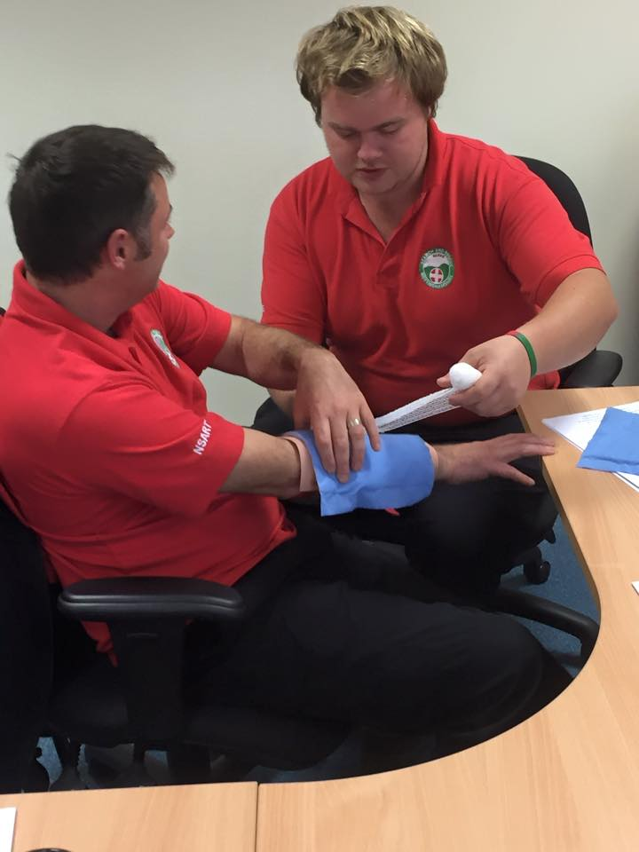
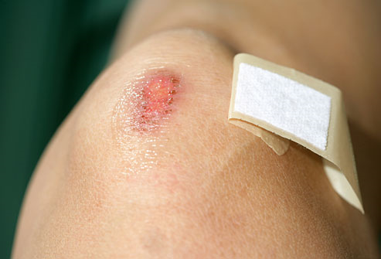
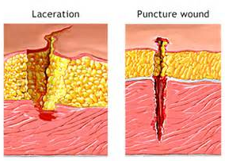
Cuts/Grazes
There are lots of different types of cuts and grazes. How you dress them depends upon what type of cut/graze it is. Your teacher will now demonstrate a few different dressing methods.
Members of Nottinghamshire Search and Rescue Team practicing bandaging October 2015
Notes:
Discuss different types of cuts and how to bandage/cover them. Link to cuts that could happen outside. Remind pupils not to remove an embedded object from a wound as this object could be “clotting” a potentially dangerous bleed.
A good idea is to speak with your school’s first aider and ask for any out of date stock. You can then use these for training purposes.

Slide 13
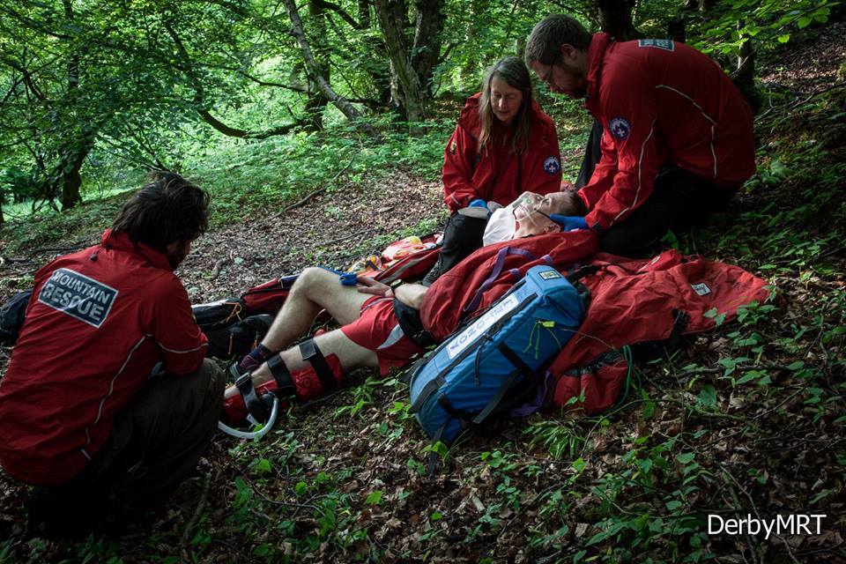
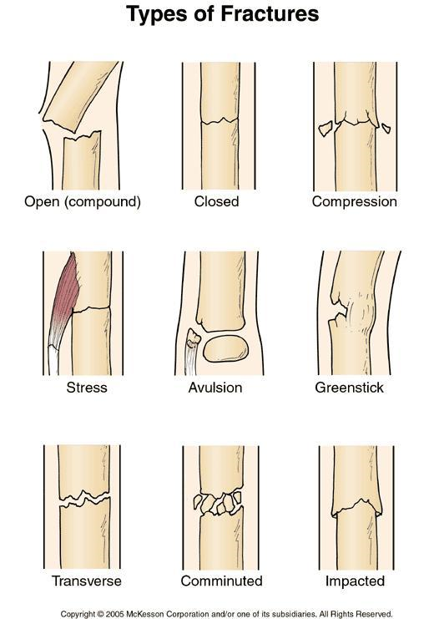
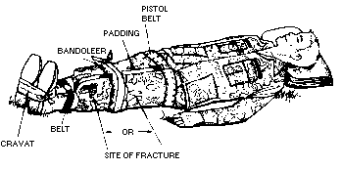
Breaks
Members of Derby Mountain Rescue Team on a training exercise, dealing with a lower leg fracture November 2015
Breaks are certainly one thing that means you must get your casualty off the hill. It is also important to immobilize the relevant limb to ensure it isn’t damaged further. Use whatever you have to hand to do this and remember keep the casualty warm.
Notes:
Discuss different types of breaks and how to immobilise a casualty until help arrives.
Get them to think how they can use the things they have to immobilise a break. Tear pieces from a bivvy bag to use as cord for tying legs together, use a map folded to support a arm fracture etc.

Slide 14
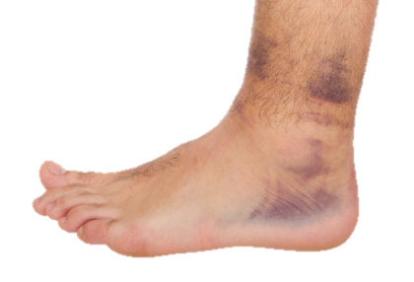
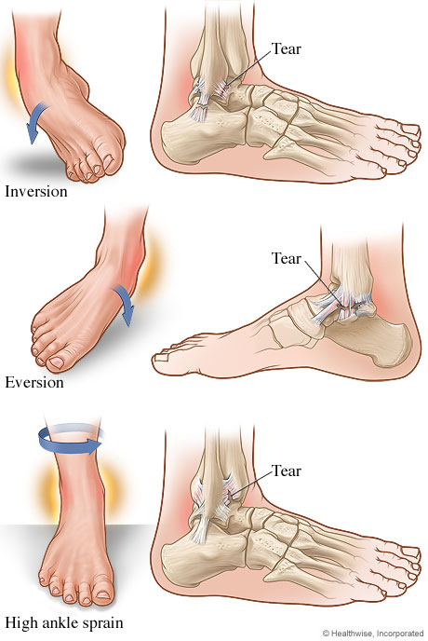
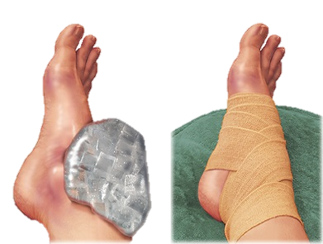
Sprains/Strains
RICE
Rest
Ice
Compress
Elevate
Sprains occur when the parts of your body holding your bones together tear. They will heal, however it will take time.
Notes:
Discuss what a sprain/strain is and how to treat it. Also discuss how to stop it in the first place – well fitted BOOTS, that support the ankle.
Again bring to the participants attention that they can use what’s around them – a stream for instance to cool the sprain.

Slide 15
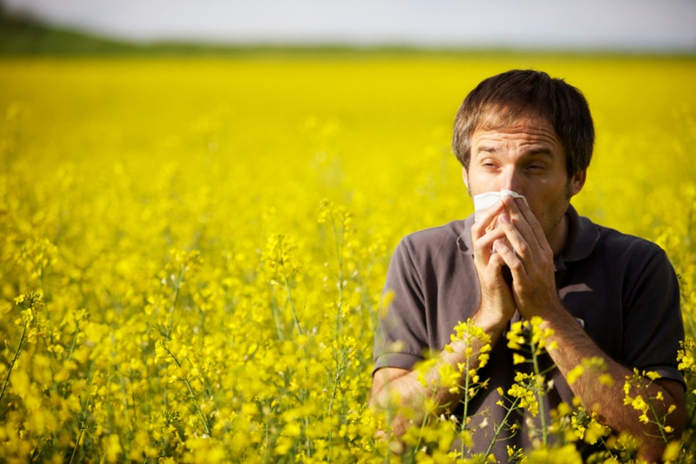
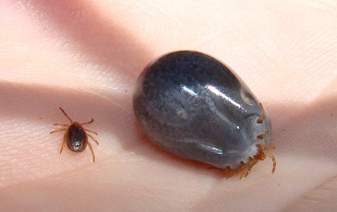
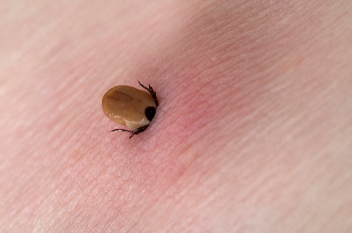
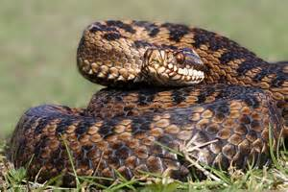
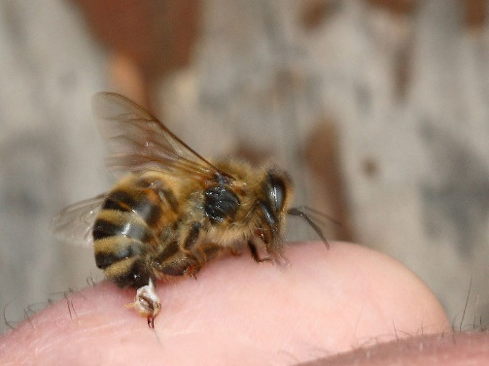
Allergic Reactions
For more information about ticks click here (scroll to the bottom of the page).
What do all of these pictures link to?
Notes:
Ask them what they think the pictures link too. Discuss Lyme's Disease for ticks, describe what ticks do, how you can get them and how you remove them. Discuss pollen allergies, stings etc and how you can treat. Discuss adder bites (the only venomous snake in the UK) – people often go into shock after being bit.

Slide 16

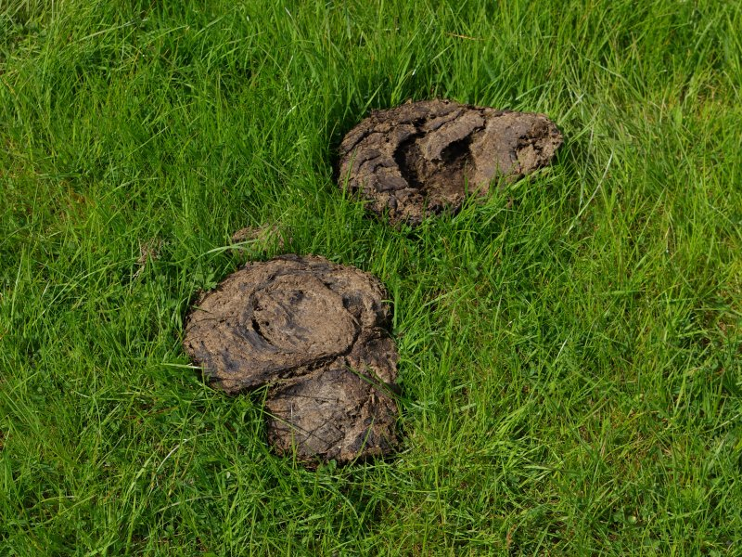
Animal Borne Diseases
E coli
E coli is found in the excrement of animals, particularly cattle. It can be caught by:
Eating contaminated food.
Touching infected animals or accidentally coming into contact with their faeces.
Contact with people who have the illness, particularly if you do not wash your hands thoroughly after using the toilet.
Drinking water from inadequately treated water supplies.
Swimming or playing in contaminated water.
Notes:
Discuss basic hygiene and how E. coli and even Leptospirosis could be contracted through poor hygiene. Also discuss what they are.
Have a discussion on drinking from streams etc. This I will leave for you to research and decide what information you pass onto participants. I have my personal opinion on the matter, however I think it is wise to allow you to choose what you pass onto your participants.

Slide 17
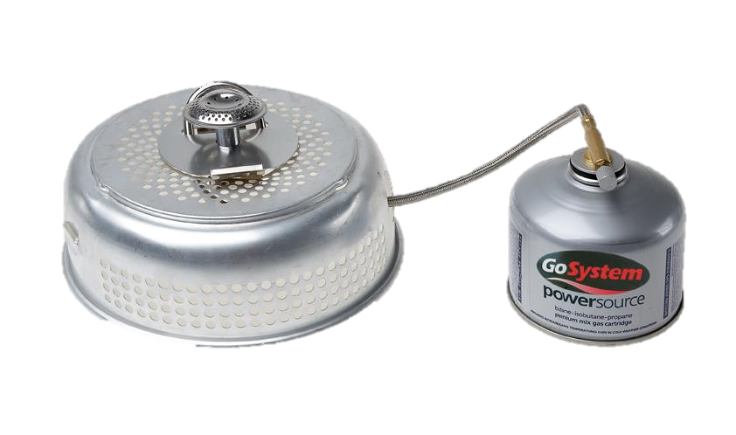
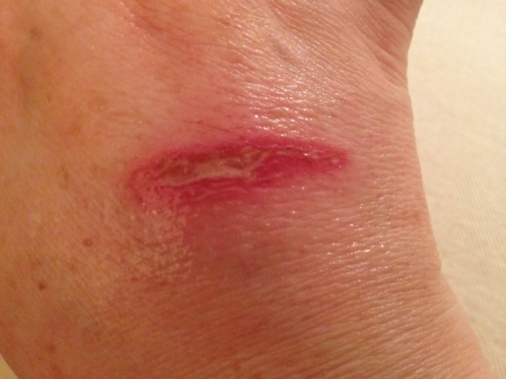
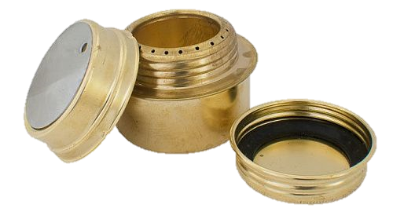
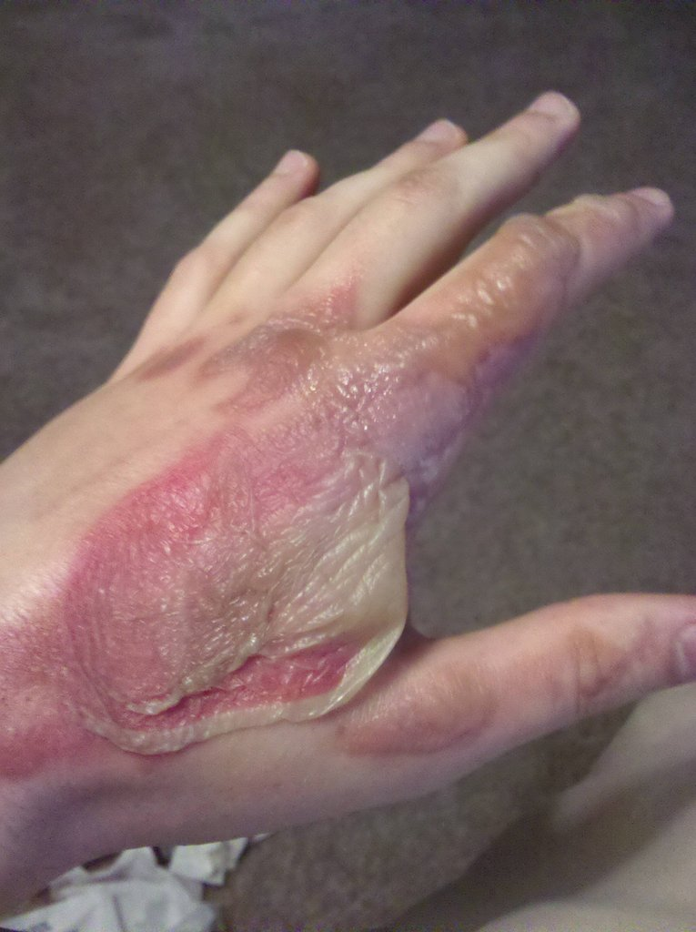
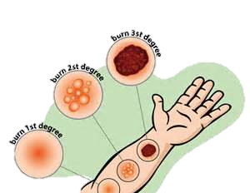
Burns
Cool
Remove
Dress
Notes:
Discuss types of burns, how they could happen and how to treat. Cool, Remove and Dress. Explain about a wet dressing and why it’s important and discuss the use of cling film.
Cool – cool the burn down with sterile liquid (bottled water, even cola, whatever you have to hand!).
Remove – remove any burnt in contaminants if you can.
Dress – dress it in a sterile dressing (damp if possible, or cling film).

Slide 18
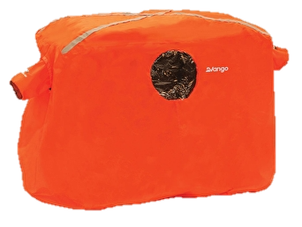
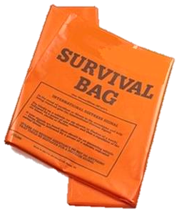
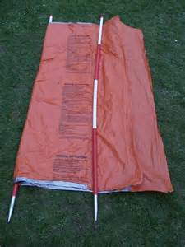
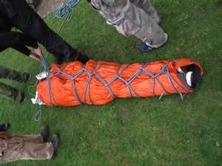
Emergency Procedure
For more information and general hill walking advice go to:
https://expededucation.org/hill-walking-advice/
Notes:
Briefly discuss the use of survival bag. They could use them to immobilise a leg by tearing strips and tying it around a leg etc. They could place it over their heads and puncture holes in it to keep warm. They could even use them as a make shift stretcher. Demo a survival bag and emergency shelter. Discuss the importance of them.
Discuss emergency procedures – each school is different so you can explain what yours is.

